Slide 2
“We should not try to cure the body without the soul”.
«Δεν πρέπει να επιχειρούμε να θεραπεύουμε το σώμα χωρίς την ψυχή».
PLATON.'' Σωκράτης εις Χαρμίδην '’ (ή '' Περί Σωφροσύνης '') § 156 e.
Plato, Charmides or on Temperance: tentative, v. III, p. 21, transl. by W.R.M. Lamb, M.A., Harvard University Press, Cambridge, Massachusetts, William Heinemann Ltd.

Slide 3
Valentin Felixoviсh Voino-Yasenetsky (April 27 (May 9) 1877, Kerch – June 11, 1961, Simferopol) – surgeon, professor of medicine.

Slide 4
Saint Luke, archbishop of Simferopol and Crimea. Laureate of Stalin prize of the first degree (1944).
As the Master always emphasized, “There is no “case” for a surgeon, but a living and suffering person”

Slide 5
Most frequently cited books by St. Luke are the Purulent Surgery Essays (honored by Stalin prize) and the work Spirit, Soul and Body.

Slide 6
Metropolitan Antony (worldly name Andrey Borisovich Bloom; June 19 1914, Lausanne, Switzerland – August 4, 2003, London) – bishop of the Russian Orthodox Church, metropolitan of Sourozh. He worked as a doctor up to November 27 1948, when he was ordained to the presbyterate.

Slide 7
“But if we turn to the Holy Writ we will see that from the very commencement of human history two areas were defined with absolute clarity: spirit and flesh. And between them there is a field of human warm-heartedness, human soul, very similar to dusk between darkness and light”.
Antony (Bloom), Metropolitan of Sourozh. Spirituality and Warm-heartedness: Discussion with Orthodox priests. Finland, Kuopio. August 1974 /Transl. from English /Moscow Psychotherapeutic Journal: Special issue Christian Psychology. 1997. №4. pp. 28-29.

Slide 8
Giuseppe Moscati (July 25 1880, Benevento – April 12, 1927, Naples) – canonized by the Roman Catholic Church, Italian doctor, scientific researcher, University professor. .
Padre Antonio Maria Sicari, the hagiographer of the saint doctor, wrote, “Not only did Moscati perceive a patient as a unity of spirit and body, and not only did he look at the disease embracing its wholesome and spiritual aspects, but he took it all as a necessary minimum for going deeper into a “human as one whole”. Treating a person as one psycho-physical whole was to reach his/her spiritual depths, inner suffering of his/her soul, inmost striving for happiness through inspiration with transcendent values”.

Slide 9
Alexey Alexeyevich Ukhtomsky (June 13(25) 1875 – August 31 1942) – Russian and Soviet physiologist, founder of the doctrine of dominant; academician of the USSR Academy of Sciences (1935), hieromonk.

Slide 10
Nikolay Ivanovich Pirogov (November 13(25) 1810 – November 23 (December 5) 1881), Vishnya village, Podolsk governorate, Russian Empire) – Russian surgeon and anatomist, natural scientist and pedagogue, founder of the Russian military field surgery, founder of the Russian school of anesthesia.

Slide 11
Vladimir Petrovich Filatov (February 15(27) 1875, village of Mikhailovka in Protasovskaya volost in Saransk county of Penzenskaya governorate – October 30 1956, city of Odessa).

Slide 12
Sergey Sergeyevich Yudin (September 27, 1891, Moscow – March 12, 1954) – prominent Soviet surgeon and scientist, chief surgeon of N.V. Sklifosovsky Research Institute of Emergency Medicine, head of A.V. Vishnevsky Research Institute of Surgery. Honored worker of science of the Russian Soviet Federative Republic, two times laureate of Stalin prize, laureate of Lenin prize.
Reproduction of the picture Portrait of Surgeon S.S. Yudin. Artist Mikhail Nesterov.

Slide 13
Gleb Alexandrovich Pokrovsky, Doctor of Medical Science, professor, laureate of state prize of the Russian Soviet Federative Republic (July 10 1925 – March 21 2008).

Slide 14
Dmitry Yevgenievich Melekhov (February 23 1899 – May 13 1979) – Soviet psychiatrist, Doctor of Medical Science, one of the founders of social psychiatry.

Slide 15
“Thus, it becomes a general and imperative requirement that a person is viewed as a whole, with the consideration of full range of his/her physical, psychic and spiritual manifestations, as a spiritual personality”. Psychiatry and problems of spiritual life. 1979.
Change of the idea about religious faith being a malignant phenomenon and viewed mainly as delusional disorders coming as part of schizophrenia.
Idea of the ability of mentally disturbed people to have normal religious faith.
Differentiation between religious experiences of mentally ill people being a sign of sickness (“false mysticism”) and religious experiences that are instances of “positive healthy mysticism”.

Slide 16
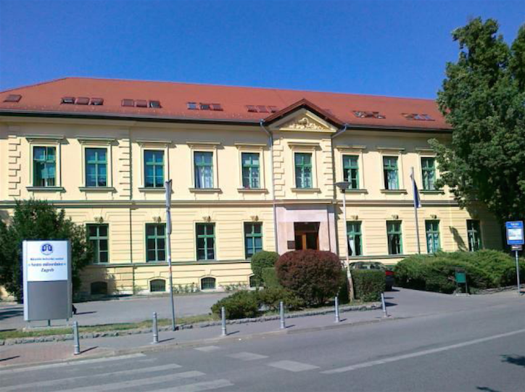
Vladimir Hudolin (May 2 1922 – December 26 1996), Croatian psychiatrist, professor, President of the World Social Psychiatric Association (1974-1978)
Sisters of Charity University Hospital in Zagreb.

Slide 17
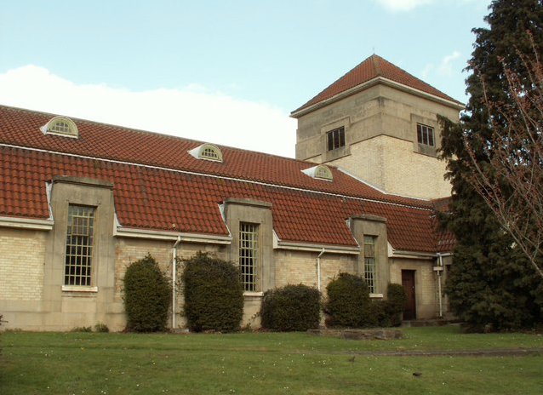
Joshua Brier (1901; Radautz, Austria – November 22 1984 Tenerife, Spain). Austrian and British psychiatrist, founder and organizer of the first three international congresses on social psychiatry (1964-1968), International Journal of Social Psychiatry (1954), London Institute of Social Psychiatry (1962), British and World Associations of Social Psychiatry (1964), pupil and successor of Alfred Adler.
Рануэлл-госпиталь в Эссексе

Slide 18
George Liebman Engel (December 10, 1913 – November 26, 1999), Doctor of medical science, American National Research Health Institute. A need for new medical model: A challenge for biomedicine, 1977.

Slide 19
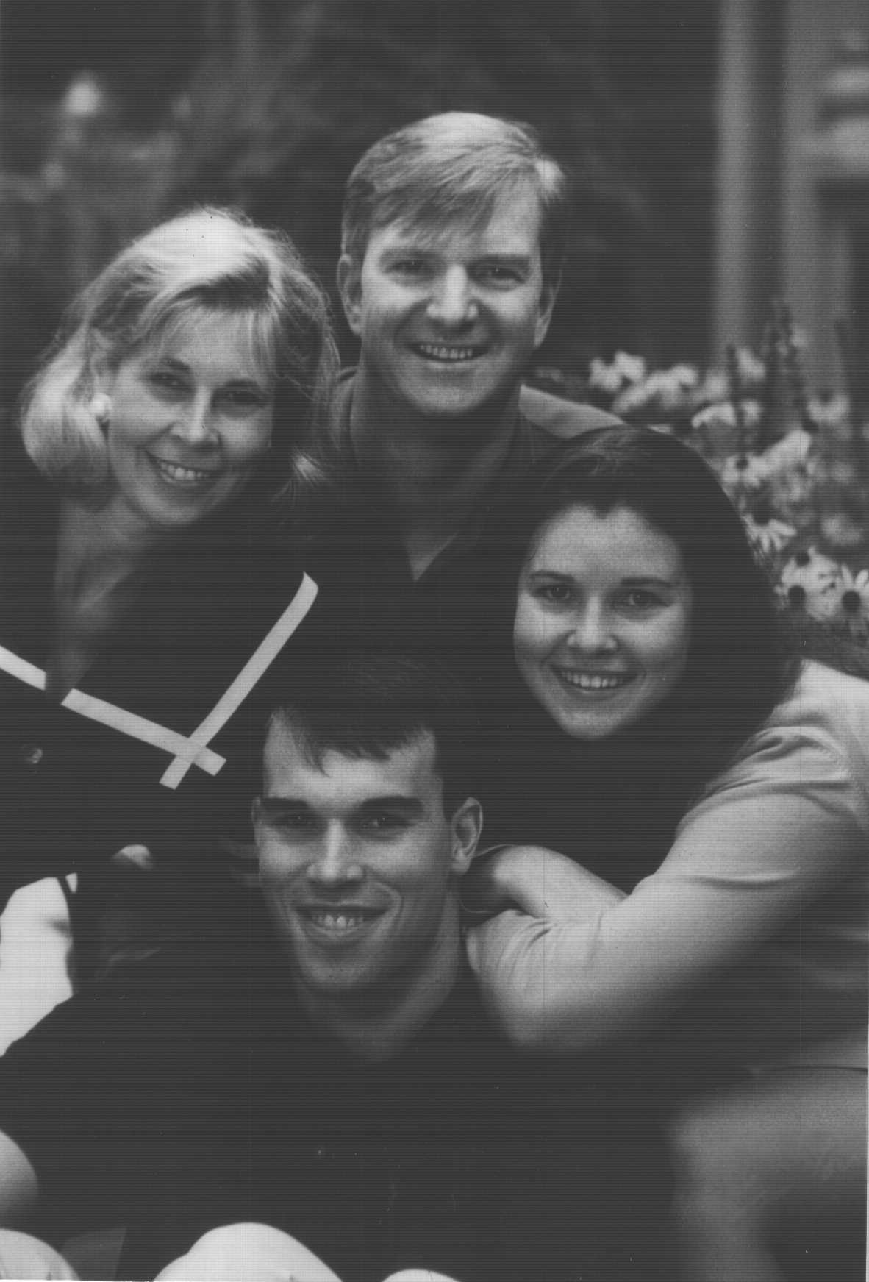
Dr. David B. Larson (1948 – March 5 2002), psychiatrist, Doctor of medical science, his wife Susan and their children Kristen and Chad.

Slide 20
Harold G. Koenig, psychiatrist, Doctor of medical science, head of the Center for Spirituality, Theology and Health (Duke University Medical Center, city of Durham, North Carolina, USA).

Slide 21
Herman van Praag, professor of psychiatry and PhD (born on November 17 1929, city of Schiedam, South Holland, Netherlands).

Slide 22
Pavel Ivanovich Sidorov (born on March 13 1953, Arkhangelsk), Doctor of Medical Science, professor, academician of Siberian branch of the Russian Academy of Sciences (elected a Fellow in 2013).

Slide 23
Mental medicine. Guidebook. Sidorov Pavel Ivanovich, Novikova Irina Albertovna

Slide 24
“But do thou, O man, form associations to restrain the madness of inebriety”. Homily I. 2 Timothy i. 1, 2. The homilies of St. John Chrysostom, archbishop of Constantinople, on the second epistle of St. Paul the apostle to Timothy.
Ποίησον, ἄνθρωπε, συμμορίας, ὥστε ἀποθέσθαι τὴν μανίαν τῆς μέθης·. τοῖς δεδεμένοις καλὰ ταῦτα τὰ φιλικὰ, τοῖς ἐν θλίψει οὖσι.
Ἐρμηνεία τῆς προς Τιμόθεον Β΄Επιστολής, Ἀγίου Ιωάννου τοῦ Χρυσοστόμου.

Slide 25
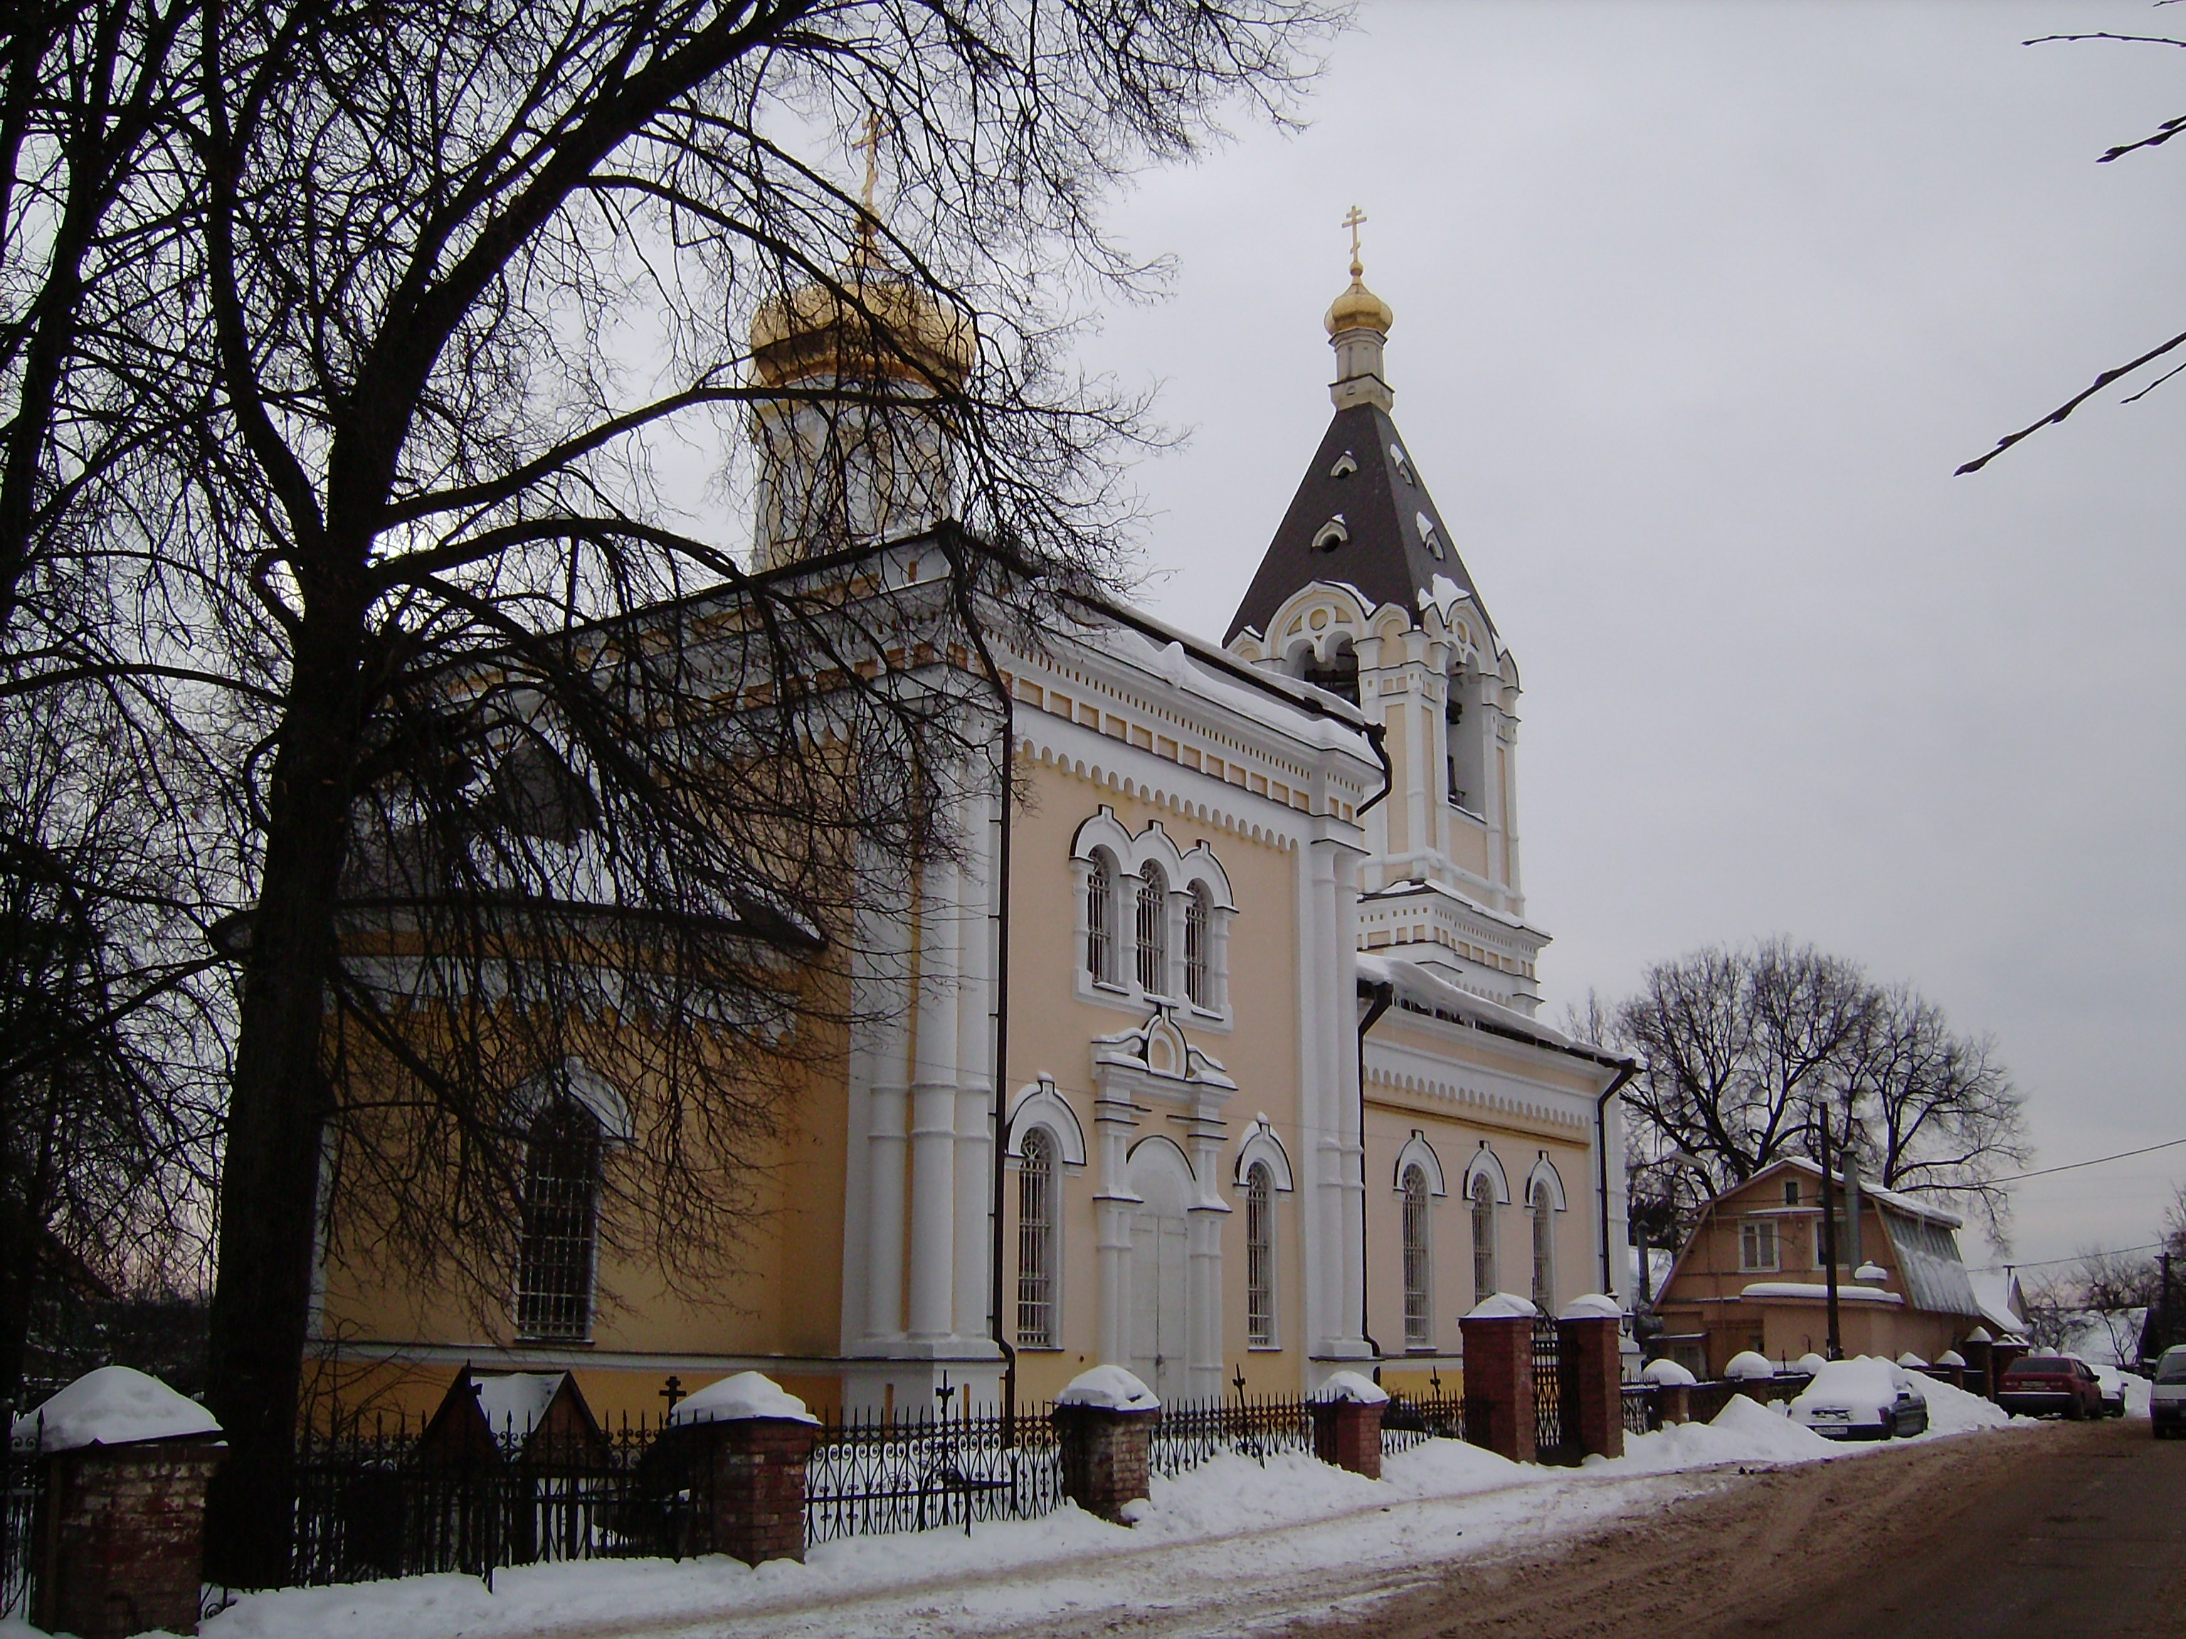
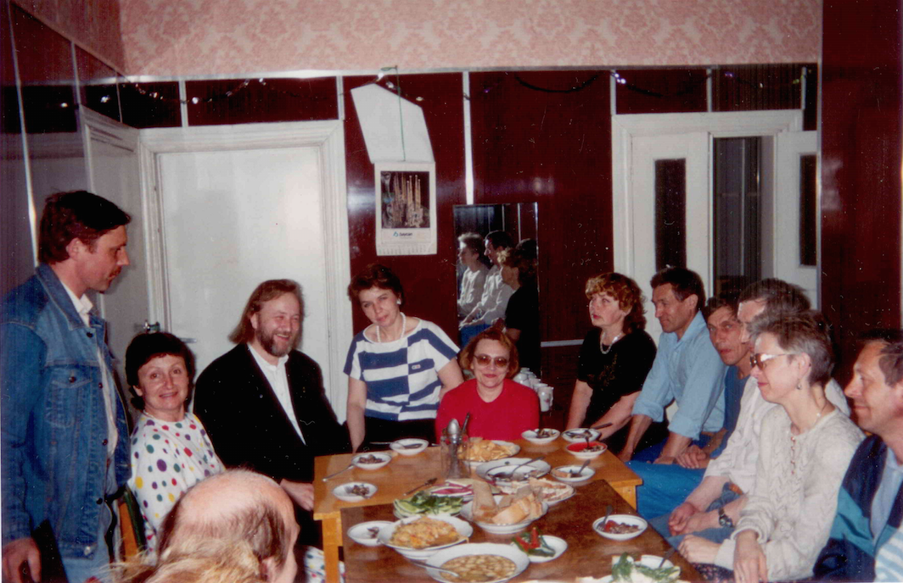
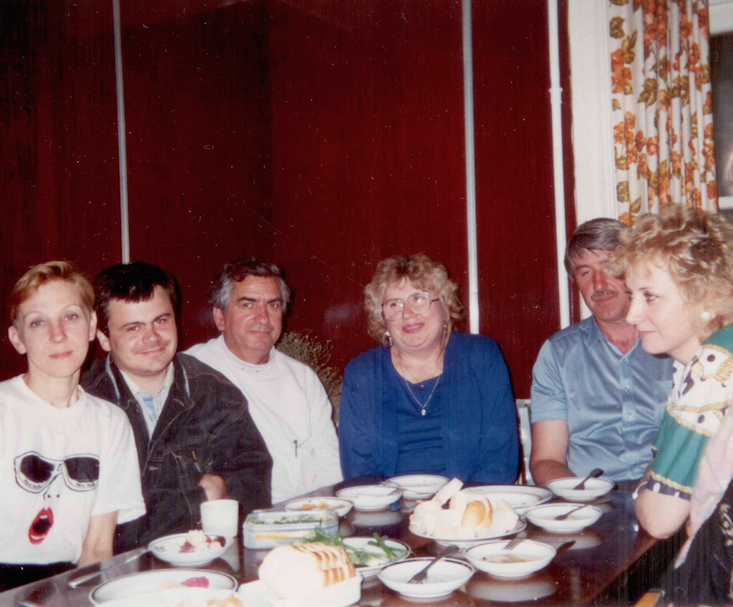
The first family temperance club in Russia with the church in the name of St. Nicholas in the township of Romashkovo in Odintsovo district, Moscow area.
December 1992.

Slide 26
The CFTC approach to treatment of religious people addicted to certain psychoactive substances, gambling is a combined action on their personality of
church sacraments,
pastoral and medical art,
psychotherapy and psycho-correction,
social environment therapy.

Slide 27
The goal of the study
define duration and quality of remission.
Research methods
Clinical
Psychological
“Short Form-36 Health Status Survey” and
“Simptom Check List-90-Revised”.
The study covered 53 people, including 35 men (66%) and 18 women (34%). Duration of alcoholism addiction was from 2 to 12 years.

Slide 28
Results:

Slide 30
Conclusions:
thus, the reviewed approach proved to be highly effective. We suppose that such results were achieved due to:
multidisciplinary approach;
parallel participation of addicted patients and their relatives in the program;
deep re-orientation of personality in values and senses as a result of actualization of a spiritual component of personality;
remission became a consequence of responsible choice of a patient as a result of restoring interpersonal relations inside the family in the course of group family work;
harmonization of patient’s personality was influenced by spiritually-directed communication in specially arranged psychotherapeutic environment;
alteration of patient’s behavior came together with the change of his/her entire life style.

Slide 31
Matvey Yakovlevich Mudrov (1776, Vologda – 1831, St. Petersburg) – doctor, ordinary professor of pathology and therapy of the Moscow State University, one of the founders of the Russian therapeutic school and military hygiene.
“Stick to what Hippocrate said. With Hippocrate you will both be the best people and the best doctors”.

Slide 32
Hippocrates of Cos (c. 460 BC, Cos island – c. 377 BC, Larissa, Thessaly)

Slide 34
“The Orthodox Church considers alcoholism a hard mental illness associated with deep damage of psychosomatic character, treatment of which is not possible without understanding by the sick person of spiritual nature of his/her malady, full and sincere repentance, turning to the fullness of the grace of Christ”.
Concept of the Russian Orthodox Church for Assurance of Temperance and Prevention of Alcoholism adopted at the session of Holy Synod of the Moscow Patriarchate on July 25, 2014.

Slide 35
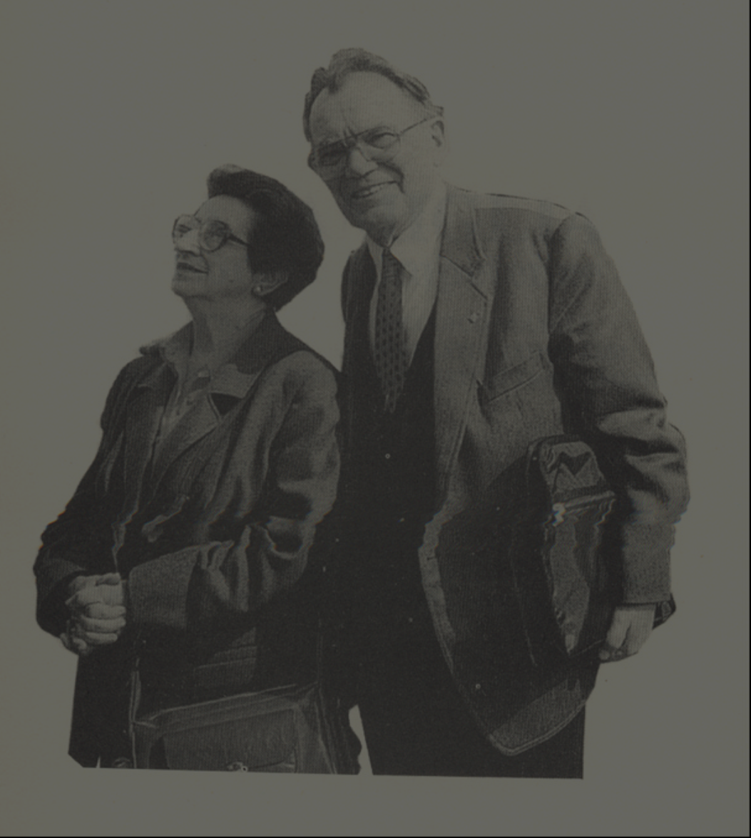
It is not alcohol that matters,
but a human being.

